Slide 1
Case Study on
Personal Finance Tracker Management System

Slide 2
INTRODUCTION
The Personal Finance Tracker Management System is designed to help individuals manage their financial activities effectively.
This project automates the process of recording income and expenses in a structured and secure manner.
It provides users with a platform to track daily transactions, monitor spending habits, and calculate current balances.
The system ensures secure access through user authentication and protects sensitive financial data.
The application follows a layered architecture using Spring Boot and REST APIs to maintain scalability and maintainability.

Slide 3
ABSTRACT
The Personal Finance Tracker Management System is a web-based application developed to help users track their income and expenses efficiently. The main objective of this project is to provide a secure and user-friendly system for managing personal financial records.
Users can register, log in securely, add income and expense transactions, view transaction history, and track their current balance in real time. Passwords are securely stored using hashing techniques to ensure data protection.
The backend of this application is developed using Spring Boot, Spring Data JPA, and Hibernate, while MySQL is used as the database. The frontend is built using HTML, CSS, and JavaScript, which communicates with backend REST APIs.
This project improves financial awareness and encourages better money management practices.

Slide 4
CLIENT REQUIREMENT
The client requires a Personal Finance Management system where:
Users can securely register and log in.
Users can add income and expense transactions.
Transactions should include amount, category, type, description, and timestamp.
Users should be able to view and delete transactions.
The system should automatically calculate total income, total expenses, and balance.
Data should be stored securely in a database.

Slide 5
WHAT WE ARE GOING TO BUILD
We have built a Personal Finance Tracker Management System with the following features:
Secure Login and Registration system.
Add income and expense transactions.
View transaction history.
Delete unwanted transactions.
Automatic balance calculation.
RESTful API-based backend architecture.

Slide 6
TECHNICAL FEATURES
Proper Login and Registration APIs.
Password hashing for security.
REST APIs using HTTP methods (GET, POST, PUT, DELETE).
Layered architecture (Controller, Service, Repository).
Input validation and exception handling.
Hibernate ORM for database interaction.

Slide 7
TECHNOLOGIES AND TOOLS USED
Programming Language: Java
Framework: Spring Boot
ORM: Hibernate / JPA
Database: MySQL
Build Tool: Maven
IDE: Spring Tool Suite (STS)
Web Server: Apache Tomcat
Frontend: HTML, CSS, JavaScript
API Testing Tool: Postman

Slide 8
SYSTEM REQUIREMENTS
Software Requirements
Backend: Spring Boot, JPA, Hibernate
Database Server: MySQL Server 8.0
Web Server: Apache Tomcat
IDE: Spring Tool Suite (STS)
Browser: Google Chrome
Hardware Requirements
Processor: Intel i3 or above
RAM: Minimum 4 GB
Storage: Minimum 20 GB free space

Slide 9
PROJECT MODULES
User Authentication Module
Transaction Management Module
Balance Calculation Module

Slide 10
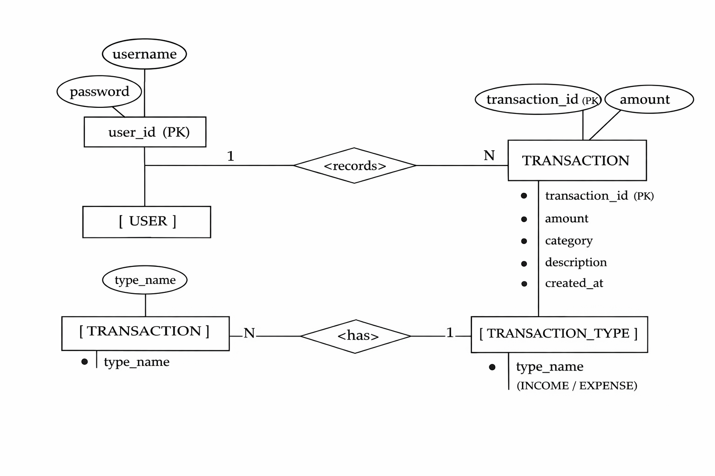
ER DIAGRAM

Slide 11
SYSTEM ARCHITECTURE
The system follows a Client–Server Architecture:
Frontend acts as the client.
Backend Spring Boot application acts as the server.
REST APIs handle communication between client and server.
MySQL database stores all user and transaction data.
Data is exchanged using JSON format.

Slide 12
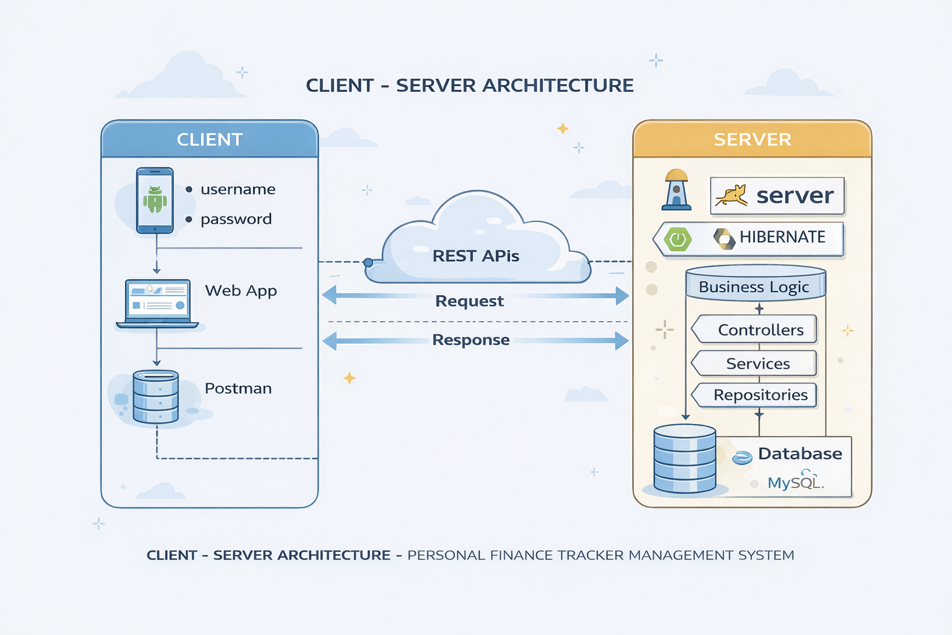
Client - Server Architecture

Slide 13
USER AUTHENTICATION MODULE
Allows users to register and log in securely.
Passwords are hashed before storing in the database.
Ensures that only authenticated users can access financial data.

Slide 14
TRANSACTION MANAGEMENT MODULE
Users can add income or expense transactions.
Each transaction includes amount, category, type, description, and date.
Users can view all transactions.
Users can delete transactions when required.

Slide 15
HTTP REQUEST METHODS USED
GET | http://localhost:8080/api/transactions | Retrieve transactions and user details
POST | http://localhost:8080/api/auth/register | Add new users and transactions
PUT | http://localhost:8080/api/users/update | Update existing data (if required)
DELETE | http://localhost:8080/api/transactions/{transactionId} | Delete transactions

Slide 16
DATA DICTIONARY

Slide 17
TABLES OF DATABASE
The database contains the following tables:
User Table – Stores user authentication details.
Transaction Table – Stores income and expense records linked to users.
Each transaction is associated with a specific user to ensure data privacy.

Slide 18
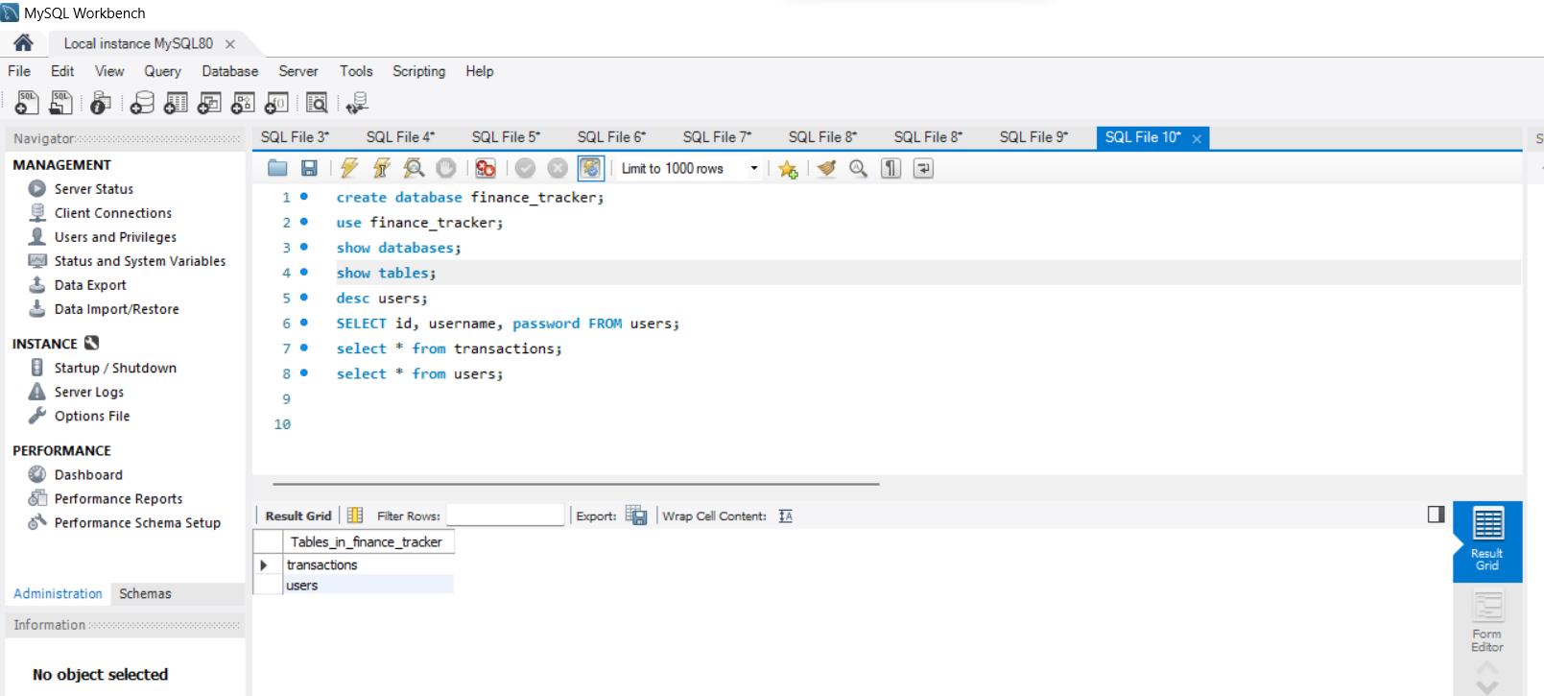

Slide 19
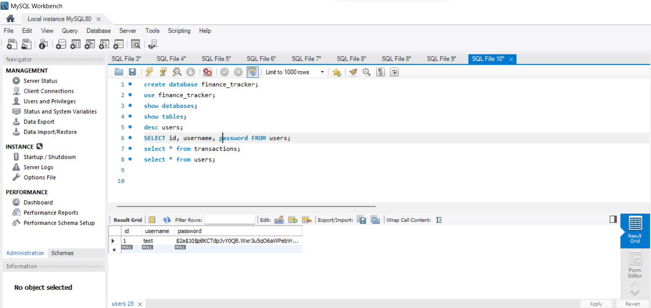
USER CREDENTIALS

Slide 20
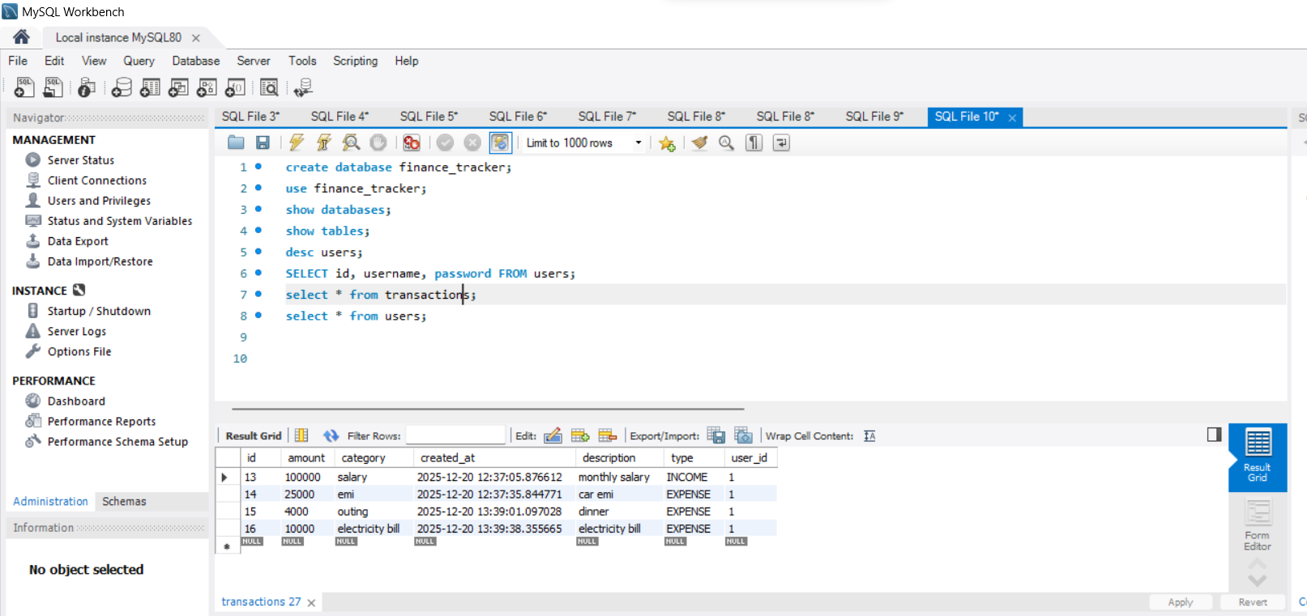
TRANSACTIONS

Slide 21
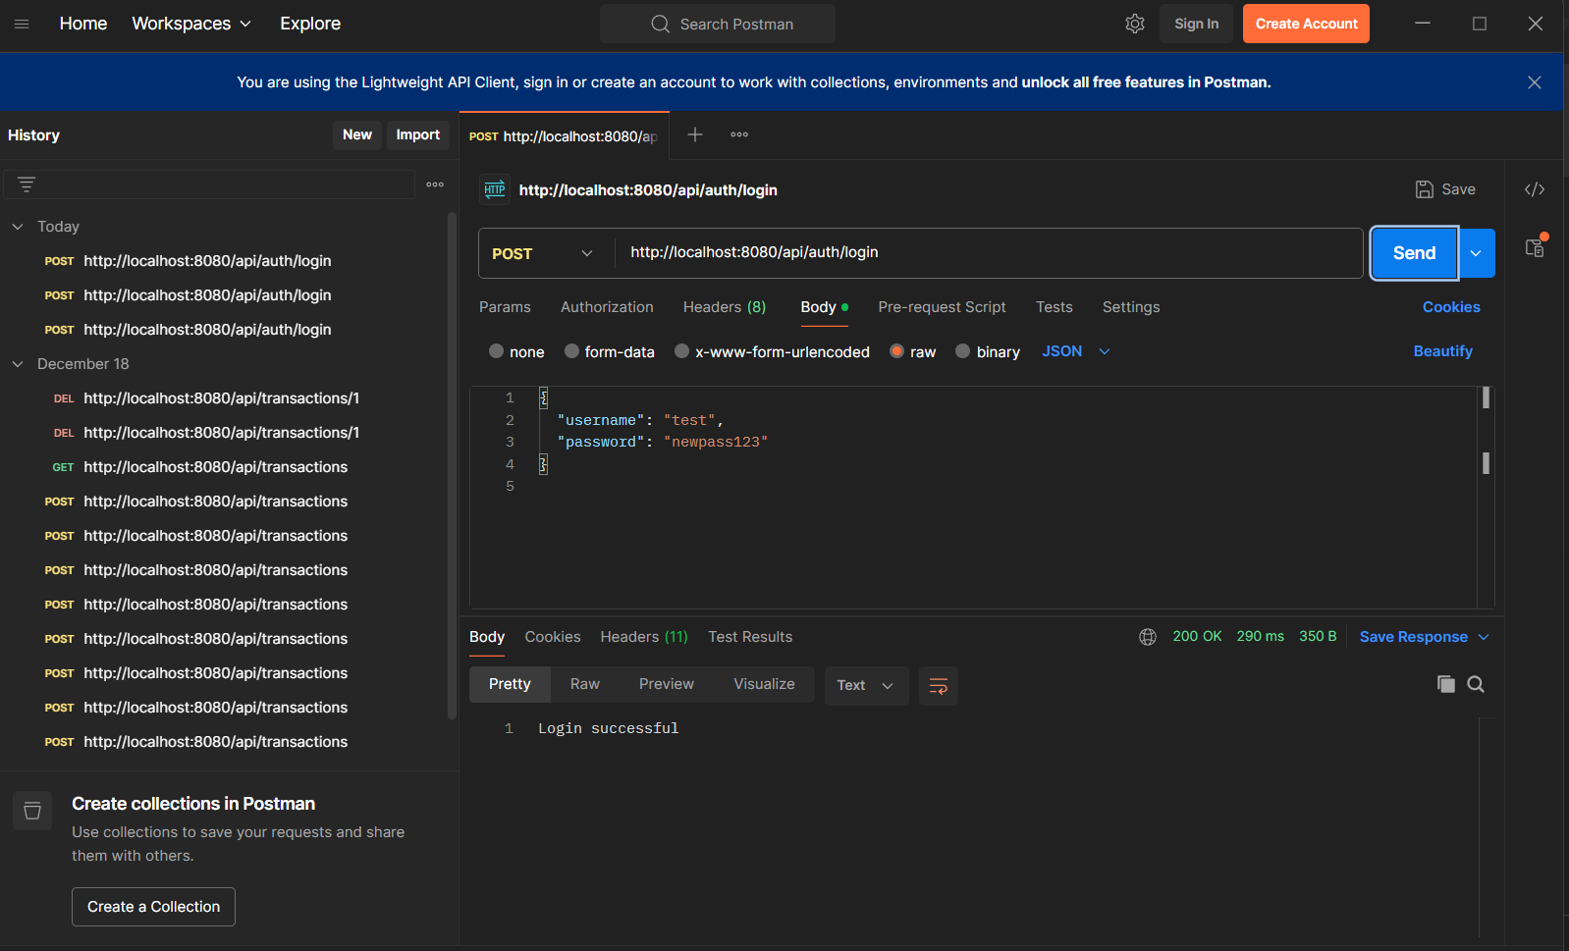
POST METHOD FOR LOGIN

Slide 22
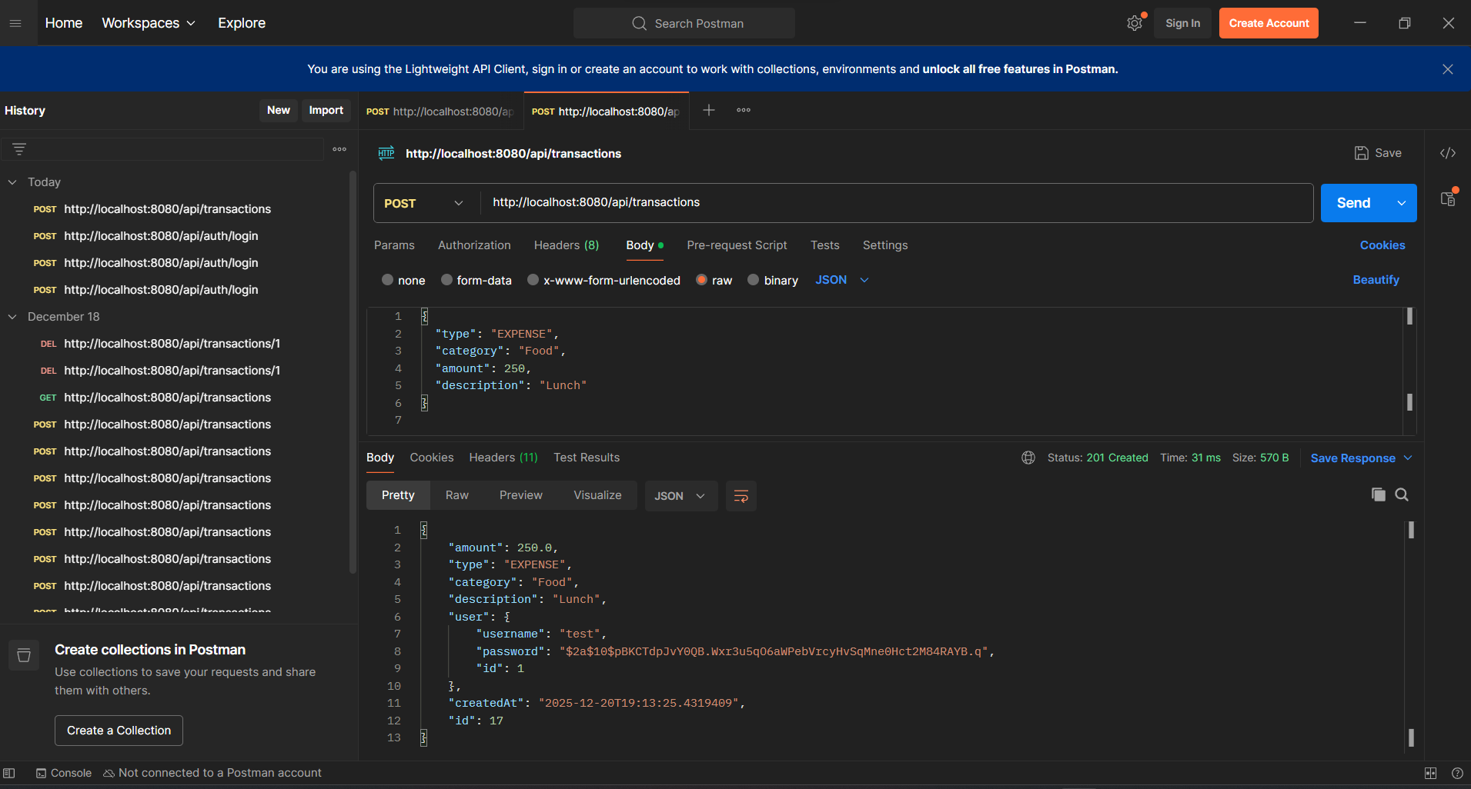
POST METHOD FOR TRANSACTIONS

Slide 23
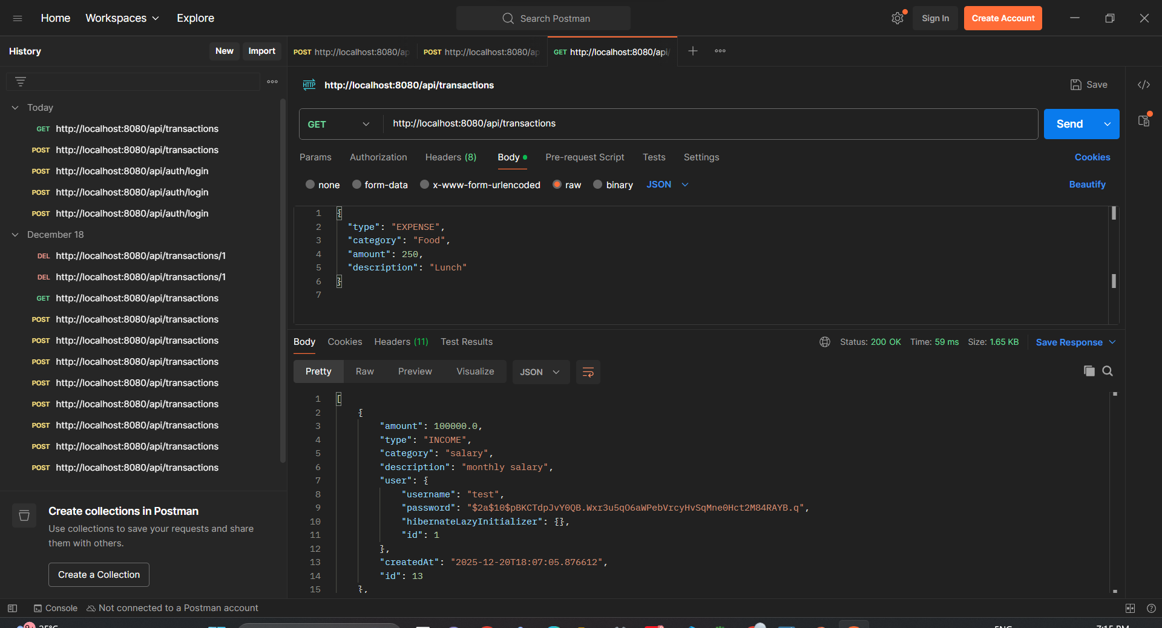
GET METHOD FOR TRANSACTIONS

Slide 24
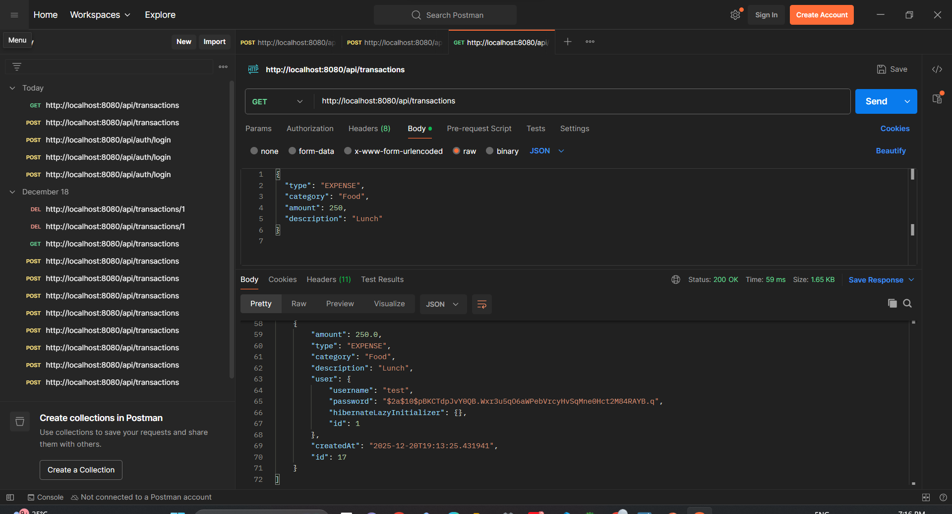

Slide 25
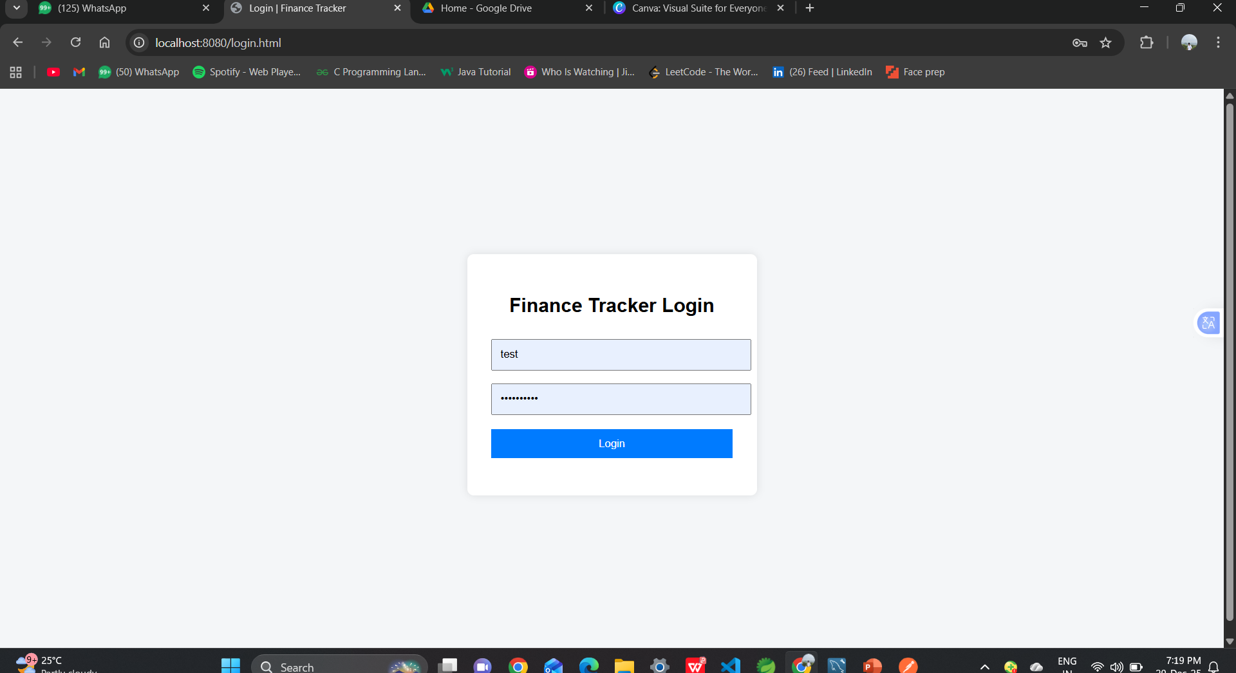
USER INTERFACE – LOGIN PAGE

Slide 26
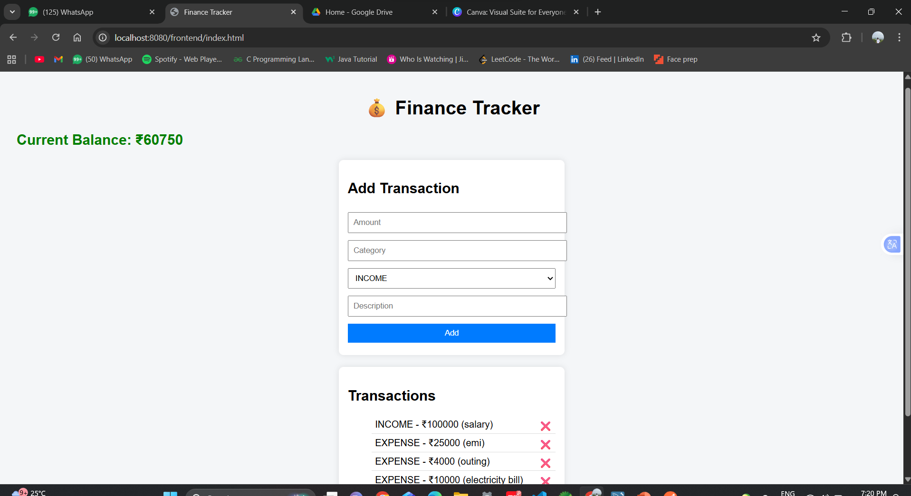
USER INTERFACE – INDEX PAGE

Slide 27
ADVANTAGES OF THE SYSTEM
Easy and efficient financial tracking.
Secure authentication and data storage.
User-friendly interface.
Real-time balance calculation.
Scalable and maintainable architecture.

Slide 28
APPLICATIONS
Personal expense management.
Monthly budgeting.
Financial habit analysis.
Student and individual money tracking.

Slide 29
FUTURE ENHANCEMENTS
Graphical reports and charts.
Monthly and yearly financial summaries.
Export data to PDF or Excel.
Mobile application integration.
Budget alerts and notifications.

Slide 30
CONCLUSION
The Personal Finance Tracker Management System provides an effective and reliable solution for managing personal finances in a secure and efficient manner. The system enables users to record, monitor, and manage their income and expenses systematically, helping them gain better control over their financial activities.
This project demonstrates the practical implementation of modern backend technologies such as Spring Boot, RESTful APIs, Hibernate, and MySQL, along with frontend integration using HTML, CSS, and JavaScript. Secure user authentication and password hashing mechanisms ensure data confidentiality and protect sensitive financial information.
By offering features such as real-time balance calculation, transaction history management, and secure data storage, the application enhances financial awareness and supports better budgeting and money management practices. The modular and layered architecture of the system makes it scalable, maintainable, and adaptable for future enhancements such as graphical reports, analytics, and mobile application support.
Overall, this project serves as a practical example of full-stack application development and provides a strong foundation for building advanced personal finance management systems.

Slide 31
LINKS:-
RECORDING LINK: https://drive.google.com/file/d/1AV3ivbFq0784k2u0Ua-UPzOJCCC-EDZx/view?usp=sharing
GITHUB REPOSITORY LINK: https://github.com/shyam162005/Shyam_43111370.git

